Slide 1
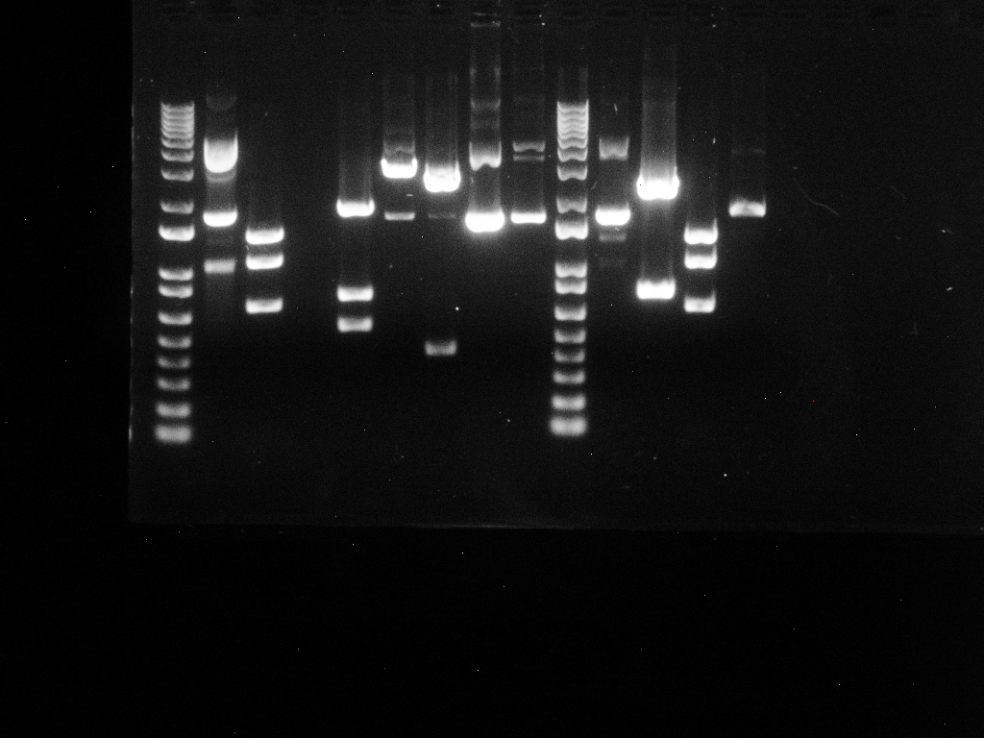
1 2 3 4 5
10180 -
4072 -
7126 -
5090 -
3054 -
2036 -
1636 -
1018 -
517, 506-
396 -
344 -
298 –
220-
201 -
154 -

Slide 2
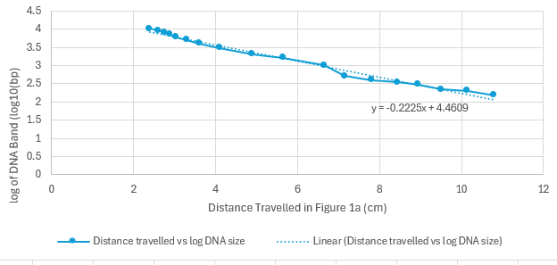
Distance Travelled vs log of DNAs
Linear line of best fit s

Slide 3
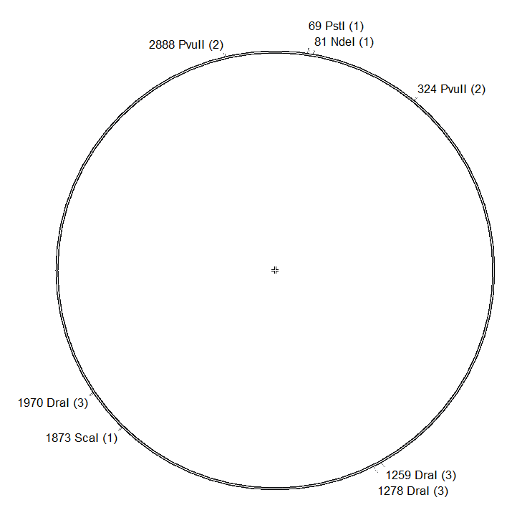
pGEM-T
3000bp

